Slide 1

Panel Data of Individual Wages
——Xiaoxuan Ma
Overview
Descriptive Facts
Distribution of Log Wage
Examining and Cleaning Outlier
Panel Data Models
Brief Answers about Other Questions
Appendix
Agenda

Slide 2

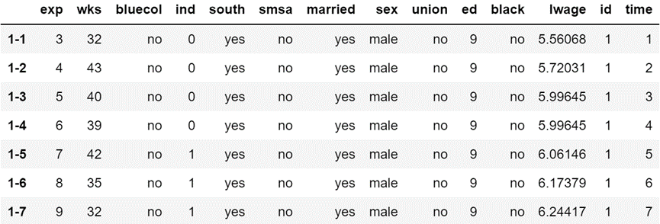
Overview
Panel data characteristics
A panel of 595 individuals from 1976 to 1982,
they have both cross-sectional and time-series dimensions.
The data includes logarithm of wages, other 3 continuous variables and 8 categorical variables.
Panel data are balanced, which means all individuals are observed in all time periods.
Due to the limited time provided, I will focus on the following questions:
1) Highlight three descriptive facts from the data with supporting analysis and graphs.
2) Pick a continuous variable of interest, what is the distribution of this variable?
3) Continuing from above, how would you examine and clean outlier?
5) Build a model from data, share with us the insights and results.
Also, I'll briefly talk about my thoughts about some other questions.

Slide 3
Descriptive Facts: Means and Variations of Variables
 |  | Standard Deviation
 | Means | Overall | Between | Within
exp | 19.85 | 10.97 | 10.79 | 1.98
wks | 46.81 | 5.13 | 3.28 | 3.94
ed | 12.85 | 2.79 | 2.79 | 0
lwage | 6.68 | 0.46 | 0.39 | 0.24
For panel data, there are 3 kinds of variations:
Overall variation: variation over time and individuals. •
Between variation: variation between individuals. •
Within variation: variation within individuals over time.
We need to characterize the variables from two dimensions: cross-sectional and time-series.
The log wage is the dependent variable for the further research, it has more between variation than within variation, which means the variation between different persons is larger than the variation of a person over time.
For the experience, the within variation is almost deterministic, because next year people will get one more year of experience, and the between variation is much larger.
For the weeks worked, the standard deviation is almost equally split.
The education variable has zero within variation, so it’s time-invariant. That is to say, the education for a person doesn’t change over time.

Slide 4
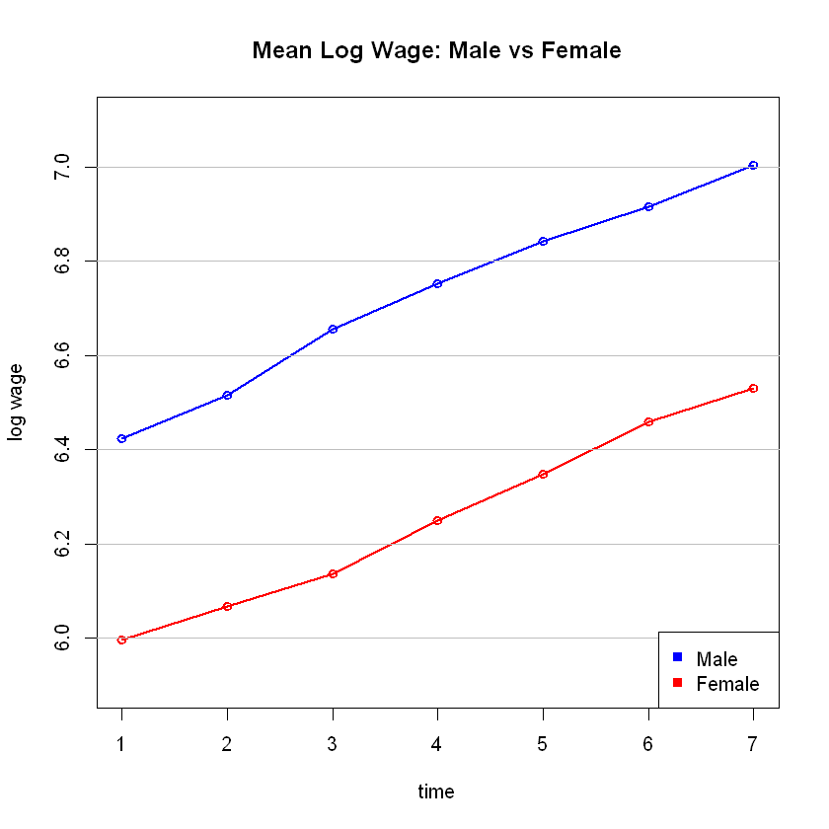
Descriptive Facts: Wage Trends of Males and Females
From the left graph, we can find the average log wages of both males and females keep increasing during the seven years.
The trends are close to two straight lines with similar slopes, which means the growth rates are stationary over time, and are close for males and females.
Males’ average log wages are always higher than females’ during the seven years. And the difference doesn’t change much.
Notes：The similar analysis can also apply to other attributes. For example, wage trends of the blue-collar vs nonblue-collar.

Slide 5
Descriptive Facts: Samples’ Distribution Characteristics
Now, I use categorical variables to discover samples' distribution characteristics.
For 1982, the most of samples are not from the manufacturing industry, not from the south, from the standard metropolitan statistical area, married, male, not from the union, not black.
Having a closer look. The proportions of blue-collar and nonblue-collar are close.
The proportion of females in nonblue-collar is higher than in blue-collar.
The proportion of black people in female blue-collar is much higher than in female nonblue-collar.
Notes：The similar analysis can also apply to other attributes. For example, manufacturing industry -> union -> married.

Slide 6
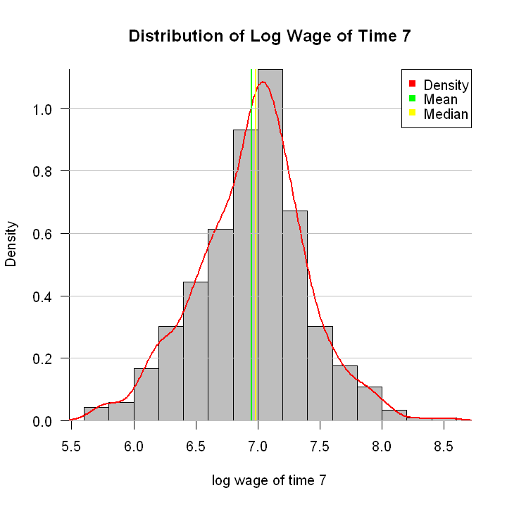
Distribution of Log Wage
Taking the log wages from 1982 as an example, let's try to find the distribution.
From the left graph, we can find the distribution looks like normal distribution.
And the mean < the median < the mode, which presents slight negative skew.
The Shapiro-Wilk normality test shows:
W = 0.992, p-value = 0.003.
Supposing alpha level is 0.05, then the null hypothesis that the data are normally distributed is rejected.
Skewness = -0.11, Kurtosis = 3.39
Overall, we can conclude that the log wage is slightly leptokurtic & negative skew distributed.
Notes：In this example, the mode means the value with the highest density. And in the Jupyter Notebook, there is an extra QQ-plot.

Slide 7
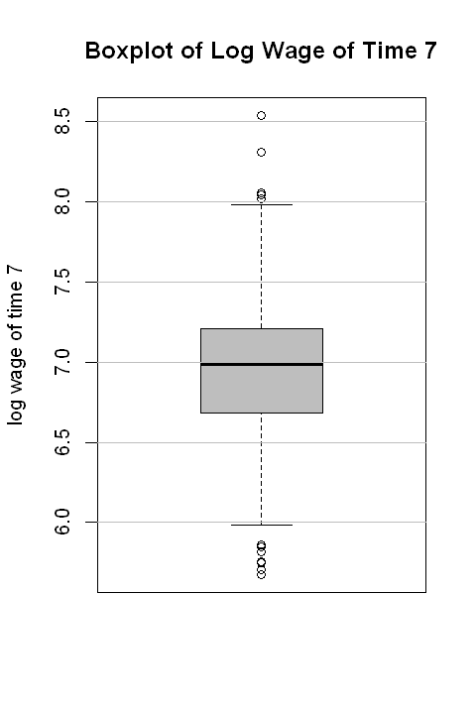
Examining and Cleaning Outlier
The leptokurtic distribution shows heavy tails, indicating the exist of outliers.
Box Plot
Boxplots are based on a five-number summary: “minimum”, first quartile (Q1), median, third quartile (Q3), and “maximum”.
Outliers are data which are out of [ Q1 -1.5*IQR, Q3 + 1.5*IQR].
6 outliers
Still taking the log wages from 1982 as an example. From the left graph, we can find 6 large outliers and 9 small outliers, this is consistent with our observations of the distribution before.
Different methods to deal with outlier:
Drop the outlier records. Mainly used when doing general analysis about cross-sectional data.
Keep the outlier records. Mainly used when trying to analyze different behaviors of different groups and analyze special/extreme situations.
Assign a new value, like mean, mode or last record. Mainly used for time series analysis.
Try a transformation. For example, try creating a percentile version of the original field.
9 outliers
Notes：Interquartile range (IQR): 25th to the 75th percentile. “minimum”: Q1 -1.5*IQR. “maximum”: Q3 + 1.5*IQR.

Slide 8
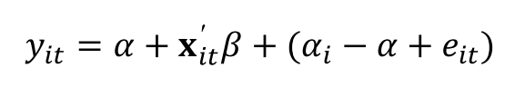
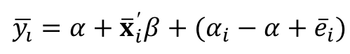
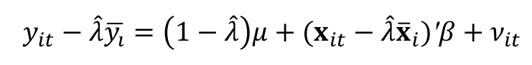
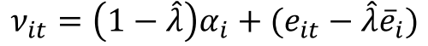
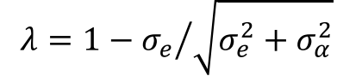
Panel Data Models: Introduction
I considered three basic panel data regression models, used package(plm) in R.
Pooled OLS Model
It uses both the between and within variation to estimate the parameters.
It is obtained by stacking the data over i and t into one long regression with NT observations and estimating it by OLS:
Between Model
It only uses the between variation (across individuals).
This is an OLS estimation of the time-averaged dependent variable on the time-averaged regressors for each individual:
Random Effects Model
The random effects estimates are a weighted average of the between and within estimates.
This is an OLS estimation of the transformed model:

Slide 9
Panel Data Models: Results and Insights
Results of 3 descriptive regression models are showed in the table.
Model:
lwage ~ exp + wks + ed + sex + married + black
Total number of observations: 595*7
All coefficients are significant(P-value < 0.05).
Hausman Test: one model is inconsistent
From the table, we can find the between model has the highest adjusted R-Squared value, indicating the best model performance. And Hausman Test suggests the random model is inconsistent.
For the coefficients, the three models showed the similar results. Experience, weeks worked, education and married have positive effect on the log wage. For example, in the between model, the coefficient of ed is 0.071, that means if the average education of a person increases by one year, then the average log wage will increase by 7.1%.
Sex and black have negative effect. In the pooling model, with the same other attributes, if a person is female / black, her log wage will decrease by 35.0% / 15.2%.
Notes：Due to the limited time, I did not perform data cleaning and standardization. For predictive models, we need to split data into fitting and testing sets or perform cross validation.

Slide 10
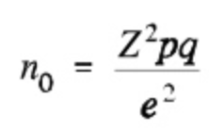
Brief Answers about Other Questions
6) Find a way to classify this dataset into 3 homogenous groups.
This is a clustering problem. Popular methods includes K-Means, Hierarchical, There are two important points.
Turning panel data into cross-sectional data, possible ways: taking average of continuous data or flatting time series.
How to characterize and interpret the groups?
7) What size of sample would you recommend?
The Cochran formula allows us to calculate an ideal sample size given a desired level of precision, desired confidence level, and the estimated proportion of the attribute present in the population.
e is the desired level of precision (i.e. the margin of error),
p is the (estimated) proportion of the population which has the attribute in question,
q is 1 – p.
8) How would you select & allocate these samples?
Stratified sampling
Cluster sampling
9) What are the pros and cons of sampling?
Advantages: Saving time, money. Lower requirement of computer.
Disadvantages: Biasness. Affecting the level of accuracy. Not easy to determine size and methods.

Slide 11
Appendix
Codes in R:
https://github.com/XiaoxuanMa/Panel-Data-of-Individual-Wages-Analysis/blob/master/Panel%20Data%20Analysis%20Codes%20in%20R.ipynb
Main Reference:
Data set: Wages Data ( https://vincentarelbundock.github.io/Rdatasets/doc/plm/Wages.html )
Panel Data Econometrics in R: The plm Package
Sample Size in Statistics (How to Find it): Excel, Cochran’s Formula, General Tips
Other Project Sample: Location Recommendation for a New Nike Store (Python)
Used Google Map API and Foursquare API to collect the data of nearby venues (including the number of restaurants, stadiums, shops, bus stops and so on) of 80 existing Nike stores and 70 unsuitable locations for stores.
Built a decision tree model based on the data to predict which location in Santa Fe might be appropriate for a future Nike store.
Made a radar plot to characterize the existing Nike stores and the unsuitable locations, visualized the two predicted locations on a Folium map.
Link: https://github.com/XiaoxuanMa/Next-Nike-Store-in-New-Mexico/blob/master/Next%20Nike%20Store%20In%20New%20Mexico.pdf

Slide 12
Thank you for reading!
Xiaoxuan Ma
Masters in Mathematical Finance
Boston University Questrom School of Business
mxx@bu.edu | www.linkedin.com/in/xxmbu

